Slide 1

SidewalkSim Running Script
February, 2022

Slide 2
1. directory
File directory: SidewalkSim
Structure:
sidewalk_raw_files: Input location of sidewalk nodes and links file (output of flythrough/sidewalk machine vision/other sensing tasks)
sidewalks.shp – sidewalk presence/absence shapefiles
crosswalk.shp – crosswalk shapefiles
sidewalkNodes.shp – sidewalk nodes
build_graph: Main running files – inputs, interim, outputs, etc.
data_node_link: location to stored the temporary outputs of sidewalk raw files processing (the ”links”)
samples_in: raw sample files, with origin coordinates and destination coordinates
samples_out: processed sample files that can be read and used by the program
results: link-by-link walking trajectory with time, speed and distance for each O-D pair
results_route: if the plotting function is allowed, the program will generate a figure for every O-D pair
core_script: Location of the running scripts

Slide 3
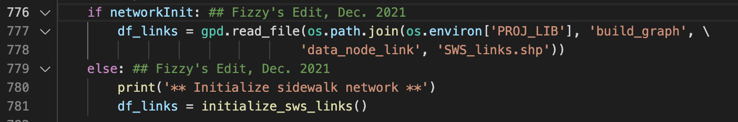
2. Sidewalk network setup
If initialization done in the previous model run (that is, the same sidewalk raw files have been used in another model run, then the content of the data_node_link can be directly copied) – import those files
If not – run initialize_sws_links()

Slide 4
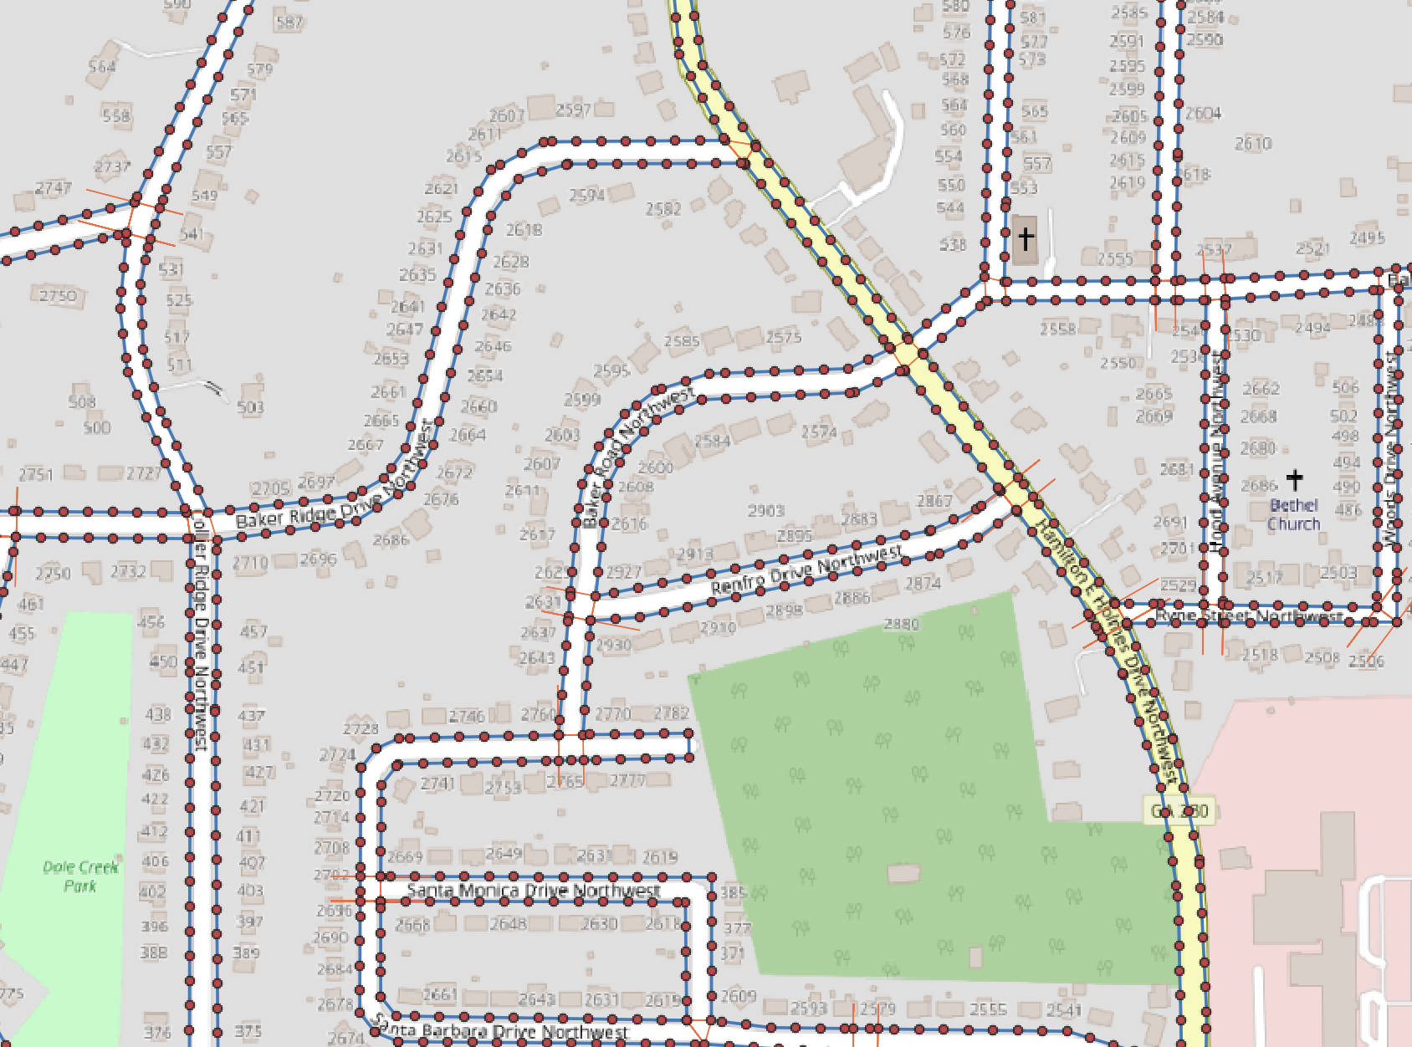
2. Sidewalk network setup
To do: Update files in sidewalk_raw_files, update column names where necessary
If initialization done in the previous model run – import
If not – run initialize_sws_links()
Inputs: sidewalks.shp, crosswalks.shp, sidewalkNodes.shp files in the sidewalk_raw_files folder

Slide 5
2. Sidewalk network setup
If initialization done in the previous model run – import
If not – run initialize_sws_links()
Inputs: sidewalks.shp, crosswalks.shp, sidewalkNodes.shp files in the sidewalk_raw_files folder
Processing:
Import files
Add geometry
Join nodes information to the origin and destination nodes of each link
Add grid information to the nodes
Get distance for each link
Store the output

Slide 6
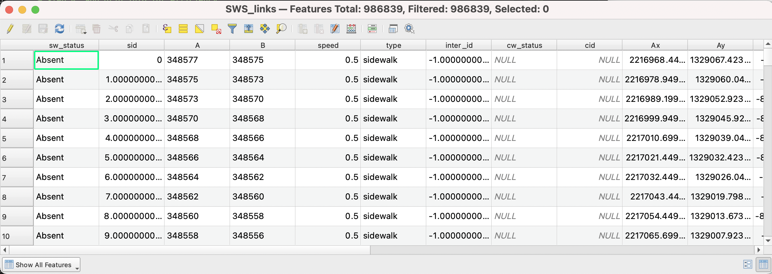
2. Sidewalk network setup
If initialization done in the previous model run – import
If not – run initialize_sws_links()
Inputs: sidewalks.shp, crosswalks.shp, sidewalkNodes.shp files in the sidewalk_raw_files folder
Processing
Outputs: data_node_link/SWS_links.shp

Slide 7
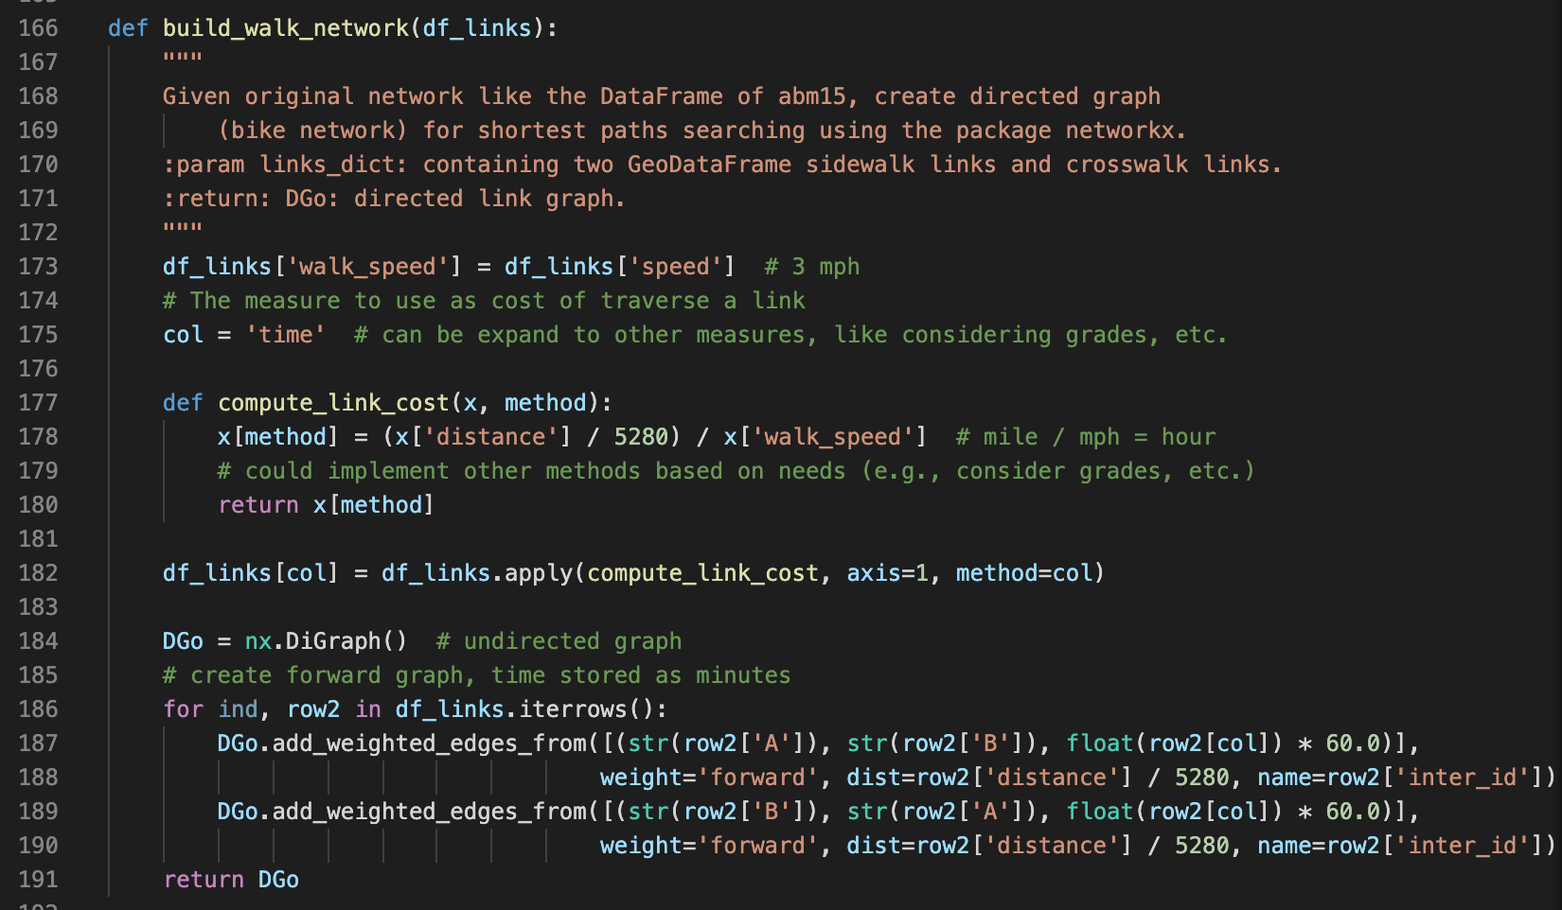
3. Build walking network
Input:
df_links: output from the previous section
Processing:
Calculate cost (currently solely based on travel time)
Create weighted network with edge = link, weight = min travel time
* for both directions (A to B and B to A, because sidewalk can be used bi- directional)

Slide 8
3. Build walking network
Input:
Processing:
Output: sidewalk network
Stored in dict_walk → dict_settings, which is used later in the run part

Slide 9
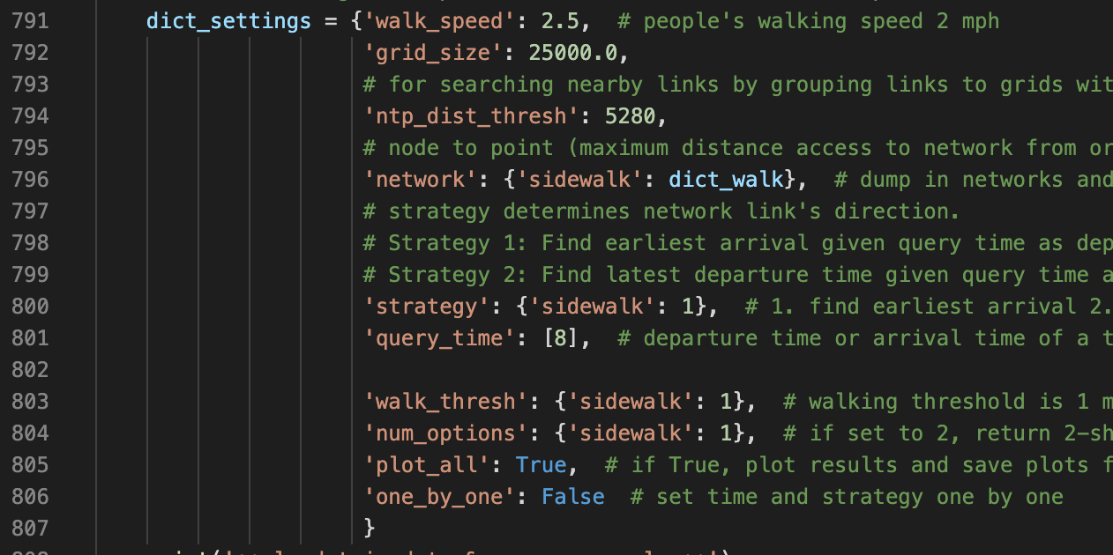
4. Parameter set-up
Parameters
Walking speed
Grid size: only searching for links that are x ft. away from a node
Node to point threshold: only search for nodes that are within the threshold distance to O or D point
Network: sidewalk network constructed in section 2 & 3
Strategy: find earliest arrival or latest departure
Query time: time of day for departure or arrival
Walking threshold: maximum number of miles that a person is willing to walk
Number of options: number of shortest paths to return
Plot: whether to plot the output trajectories (true or false)
One by one: set individual time and strategy (true or false)

Slide 10
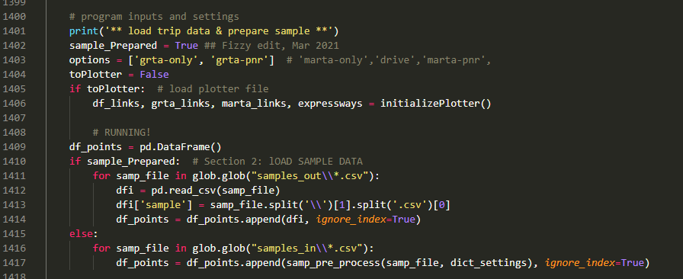
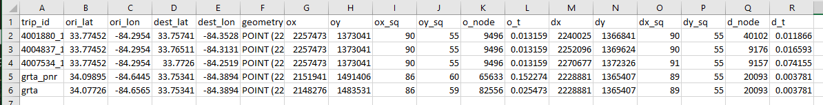
5. Prepare Samples
sample_Prepared: if True, read and stack all files in the samples_out folder, otherwise, …

Slide 11
6. Run
allRun(): iterate over the input O-D pairs, initialize the BIGRun function for every sample O-D pair
BIGRun(): go through a screening with the determine_Need function, if a route is potentially available, initialize the route finder function
determine_Need: compare walking distance to threshold and determine if the link is walkable.
Threshold: decided by the dictionary setting
Walking distance: calculated as linear straight-line distance in miles
Route finder function: set up parameters as needed, and then initialize the k_shortest_paths function to find the desired number of walking paths, and (if asked) initialize the plotter function to plot the output trajectory

Slide 12
6-*. Plot
toPlotter: T/F parameter that decides whether to plot

Slide 13
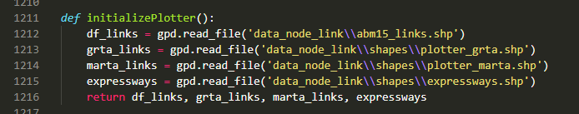
6-*. Plot
toPlotter
initializePlotter(): read in GIS files
Inputs:
plotter_[…].shp files from the preparePlotterLinks() function in the previous script (data_prep_df.py)
abm15_links.shp, ABM links shapefile
expressway.shp, expressway shapefile
Processing: read these files as df_links, grta_links, marta_links, & expressways

Slide 14
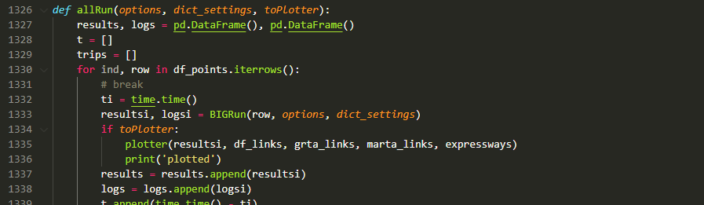
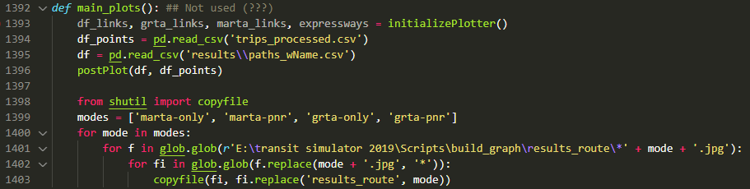
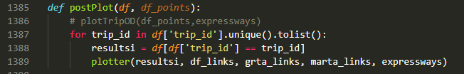
6-*. Plot
toPlotter
initializePlotter()
plotter(): plot
Called out in allRun()
(or it could also be called standalone in main_plots() → postPlot())
Inputs:
df_links, grta_links, marta_links, & expressways read from initializePlotter()

Slide 15
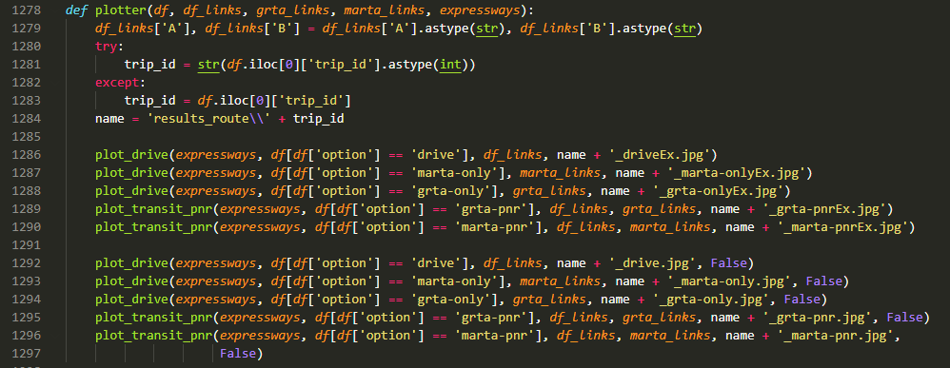
6-*. Plot
toPlotter
initializePlotter()
plotter(): plot
Called out in allRun()
(or it could also be called standalone in main_plots() → postPlot()) (???)
Inputs:
df_links, grta_links, marta_links, & expressways read from initializePlotter()
Processing:
Plot the route (red, for PNR, red for drive and blue for transit) on the context of all links (black)
For all modes (what if not all modes are enabled???)
Save as [trip ID]_[mode].jpg

